Slide 1
Weighted Index Number

Slide 2
Weighted Index Number
In weighted index number rational weights are assigned to all the items or commodities. Such weights indicate the relative importance of the items included in the calculation of the index. In most cases quantity of usage is the best measure of importance.

Slide 3
Weighted Aggregative Price Index
In weighted aggregative price index, the weights are assigned to each item in the basket in various ways and the weighted aggregates are also used in different ways to calculate an index. In most cases quantity of usage is used to calculate price index number. Laspeyre’s price index and Paasche’s price index are the two most important methods of calculating weighted price indices.

Slide 4
Laspeyre’s price index number
Laspeyre’s price index number is the weighted aggregative price index number which uses base year’s quantity as the weights. It is given by:

Slide 5
Paasche’s price index number
Paasche’s price index number is the weighted aggregative price index number which uses current year’s quantity as the weights. It is given by:

Slide 6
Fisher’s price index number
Fisher price index number is the square root of the product of the index numbers of Paasche and of Laspeyre.

Slide 7
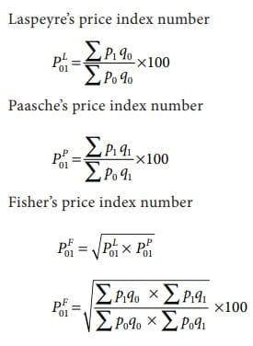
SUMMARY:-

Slide 8
Weighted Price Relative Method
Under this method price index is constructed on the basis of price relatives and not on the basis of absolute prices. The price index is obtained by taking the average of all weighted price relatives. It is given by

Slide 9
In a weighted price relative index, weights may be determined by the proportion or percentage of expenditure on them in total expenditure during the base or current period. In general, the base period weight is preferred to the current period weight. It is because calculating the weight every year is inconvenient.

